Slide 1

How did Altair’s RapidMiner help Team 3322 Achieve Success?
Presented by Team 3322: Eagle Evolution

Slide 2
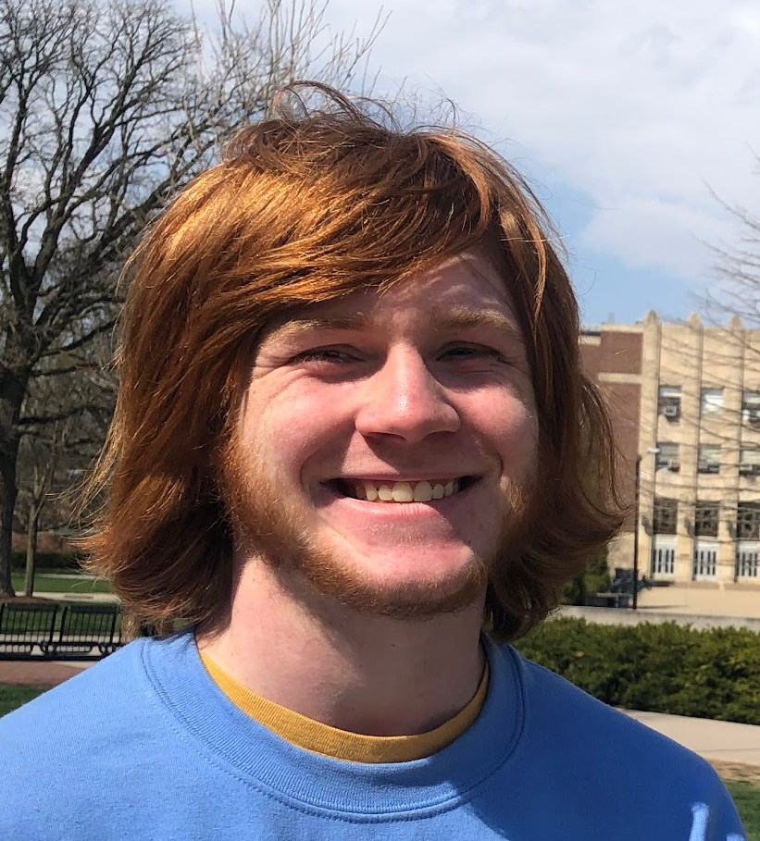
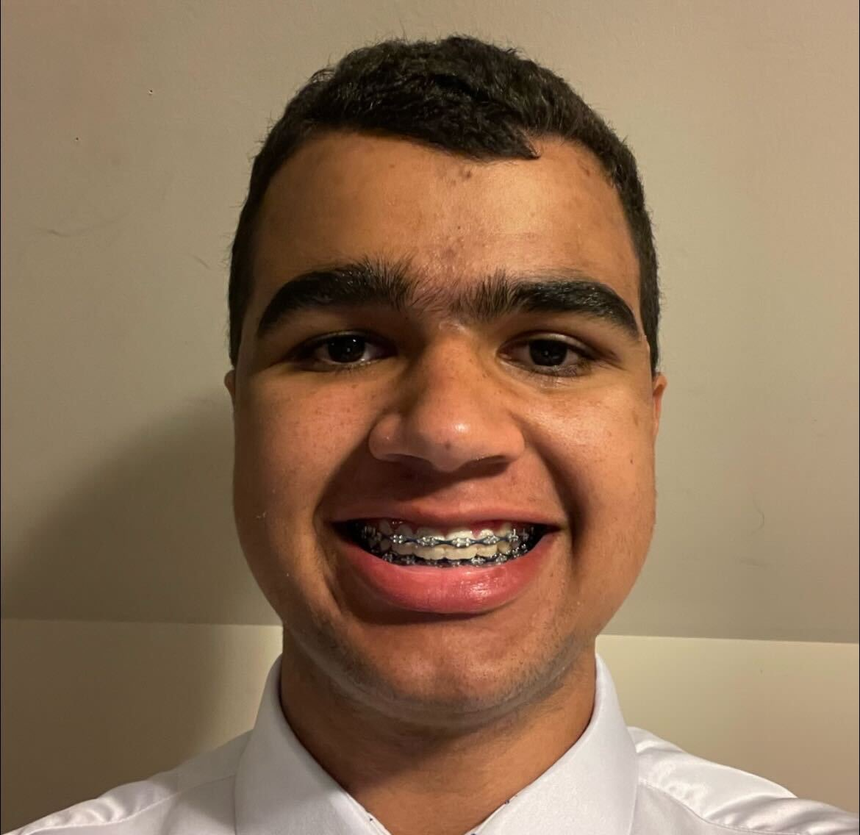
RapidMiner Allowed Team 3322 to Visualize Shot Data in the Crescendo Competition
Challenge:
3322 wanted an easy way to see where teams were shooting from and how accurate they were.
Marek Gustitus: 3322 Scouting Team Lead - Skyline High School
Sean Goodson: 3322 Scouting Team - Skyline High School
Solution:
Using RapidMiner, we developed a shot chart that allowed our scouting team to capture where shots were taken from and if they were makes or misses.
Value:
The team was able to leverage the data to help pick well matched alliance partners and to make strategic design decisions as the season progressed.
“Altair's RapidMiner gave me insight and experience with big data without having taken AP Statistics ”
– Name of person
“RapidMiner made the separation of data for the shots much easier and cleaner. It was incredibly helpful when scouting.”
-Marek

Slide 3
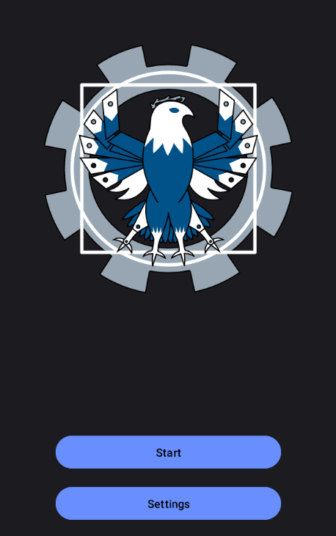
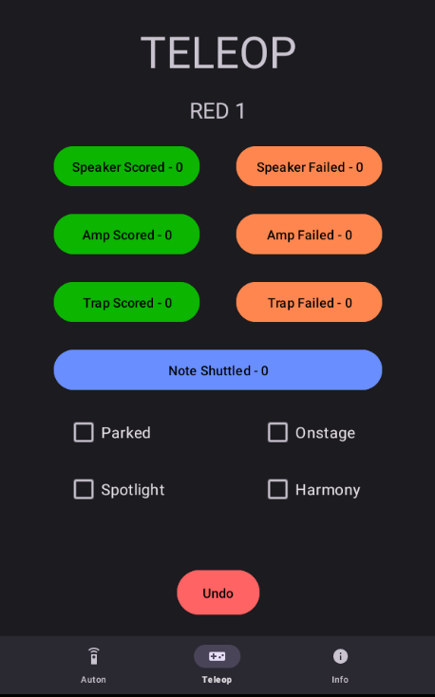
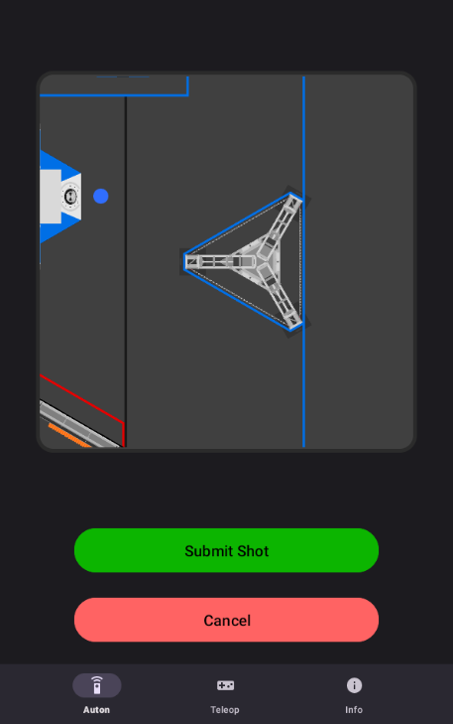
Our App

Slide 4
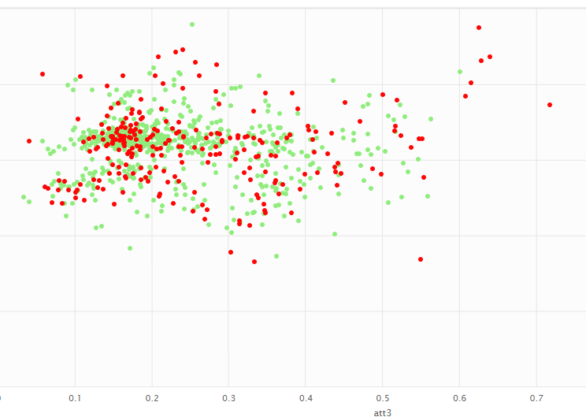
Our Shot Chart
With RapidMiner it was EASY to sort this data by team and event for maximum efficiency
Chart includes all shots from all teams at our 1st competition

Slide 5
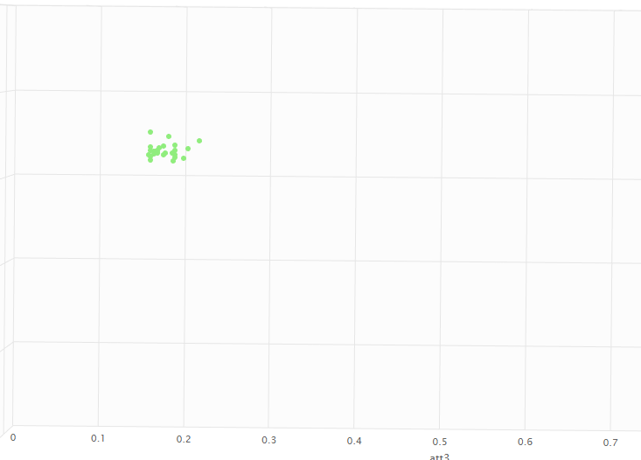
3322 Chart
Chart for a single team illuminates shooting preferences and accuracy
Especially for our Week 1 competition, 3322 was:
highly accurate
limited to one shooting location

Slide 6
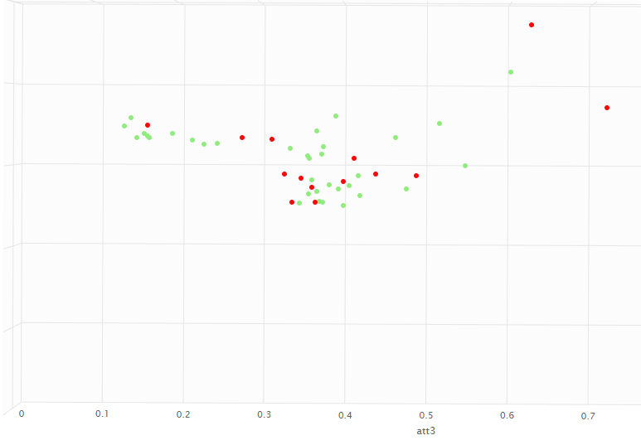
Pivoting Shooter
Chart for a single team illuminates shooting preferences and accuracy
This team was:
Less likely to conflict with our preferred location
Had some accuracy issues from distance

Slide 7
How The Shot Chart Helped Us
The shot chart helped us identify teams for alliance selection that:
Were highly accurate
Could shoot well from distance
Did not overlap in the same scoring locations as we did
The shot chart also helped us make strategic design decisions between our Week 1 and Week 3 competitions:
We found that in Week 1, pivoting shooters had low accuracy at distance.
The scout team presented this information to team leadership and our subteams.
Collectively as a team, we then we able to make the most efficient decisions for what subsystems of the robot would be upgraded before our week 3 competition - in this case, we decided that upgrading to a pivoting shooter would not be as valuable as focusing on trap and auton improvements.

Slide 8
Going Forward
Easier Analysis
Match Strategy
Communication
How we plan to use RapidMiner in the future

Slide 9
Future Possibilities using RapidMiner
Currently:
Our data:
Have to manually compare many different factors in one spreadsheet to find the best teams
Total Notes Scored to simplify
Rely on Statbotics EPA
Miss out on the value from data collected in the last qualifying matches
Simple, but has inaccuracies
"Easy Event Syndrome"
With RapidMiner:
Data Visualization will help us quickly find the best teams for our alliance
Machine Learning tools will help us assess each team's overall strength using our own data
Enable the team to start looking for other team’s trends within a competition - steady improvement from start to finish

Slide 10
Match Strategy with Real-Time Analysis
Presently, we do not often discuss strategy with driveteam before each qualification match as we cannot interpret the data fast enough
Next year, we are planning on using bluetooth to update the data after each match
Using RapidMiner real-time analysis, we can then help provide our alliance the optimal strategy for each match based on the strengths our alliance members and opponents. (Time with drive team is scarce - we need to use it well)

Slide 11
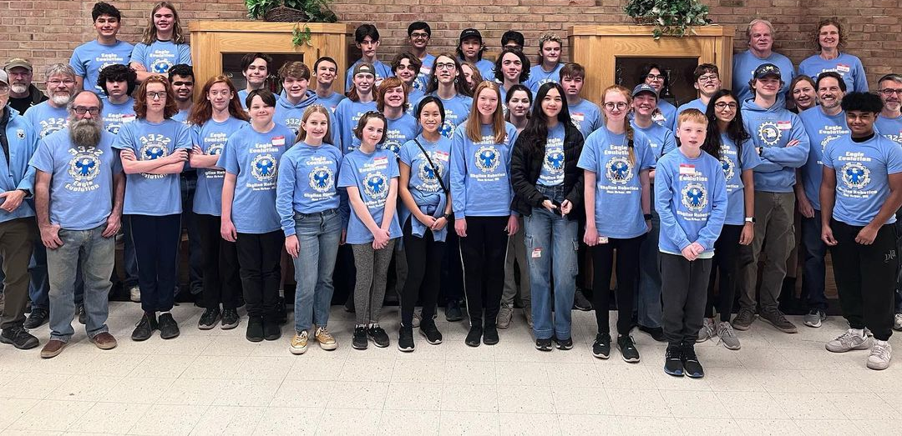
On behalf of Team 3322, we thank Altair for their continued support and appreciate the opportunity they have given us!

